Slide 1



National Education Society ®
Jawaharlal Nehru New College of Engineering, Shivamogga
Dept. of Electronics and Telecommunication Engineering
Mini Project Final presentation on
“LPG Gas leakage detector using Arduino”
Presented By:
Darshan N J (4JN23ET013)
Indudhara K (4JN23ET020)
Manoj Kumar G G (4JN23ET028)
Rohith Shreyams Chulaki (4JN23ET045)
Branch: Electronics & Telecommunication Engineering
Under The Guidance of:
Prof. Madhukar C S.
ETE Dept. JNNCE Shivamogga

Slide 2
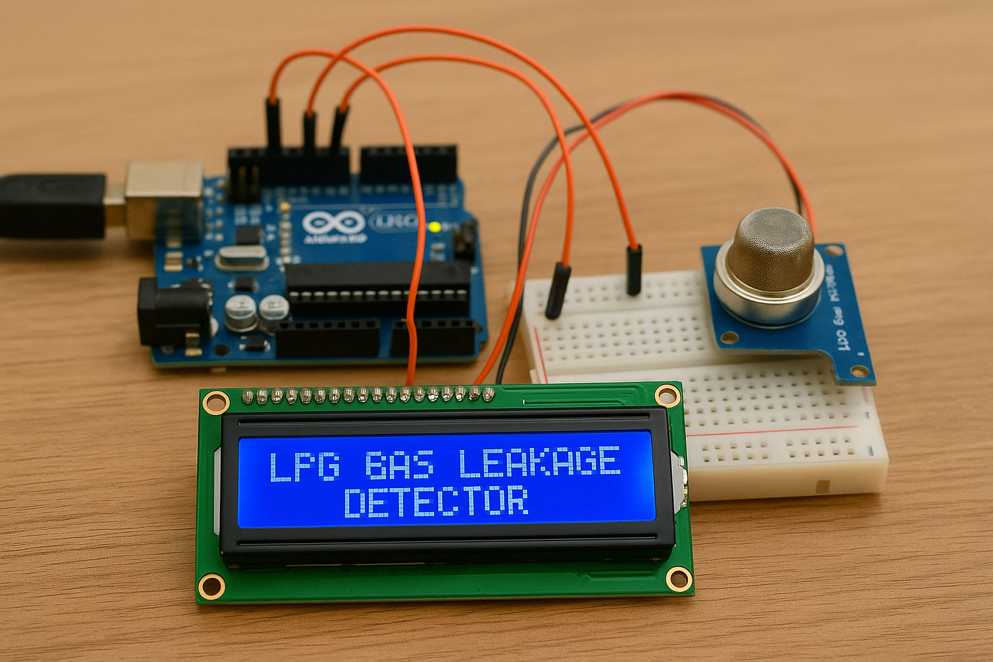
Contents:
Introduction
Aim Of The Project
Objectives
Hardware Requirements
Literature Survey
Methodology
Objectives And Methodology
Block Diagram
Circuit Diagram
Implementation Details
Advantages
Future Scope and Enhancements
Conclusion
Reference

Slide 3
INTRODUCTION:
LPG is a common household and industrial fuel, but its leakage can cause severe fire accidents and health hazards.
This project proposes an LPG gas leakage detector using a gas sensor and Arduino to continuously monitor gas levels.
When leakage is detected, the system immediately triggers an alarm to alert the users.
The system is cost-effective, reliable, and enhances safety in homes and industries.
Accidental leakage of LPG can lead to fire hazards, explosions, and serious health risks. Therefore, early detection of gas leakage is essential to ensure safety and prevent life-threatening situations.

Slide 4
Aim of the Project
The aim of this project is to design and develop a low-cost, reliable LPG gas leakage detection system.
To implement a microcontroller-based LPG leakage detection and alert system using an MQ-2 sensor and Arduino, capable of continuously monitoring gas levels and providing instant warnings to ensure household and industrial safety.

Slide 5
Objectives
To detect the presence of LPG gas leakage and activate a buzzer.
To display the gas leakage status on the lcd and automatically turn on the exhaust fan to reduce the gas concentration.
To send an alert message to the user’s mobile phone using a GSM module and servo motor automatically turns off the gas regulator when gas leakage is detected.
To ensure safety in domestic and industrial areas by using this system.

Slide 6
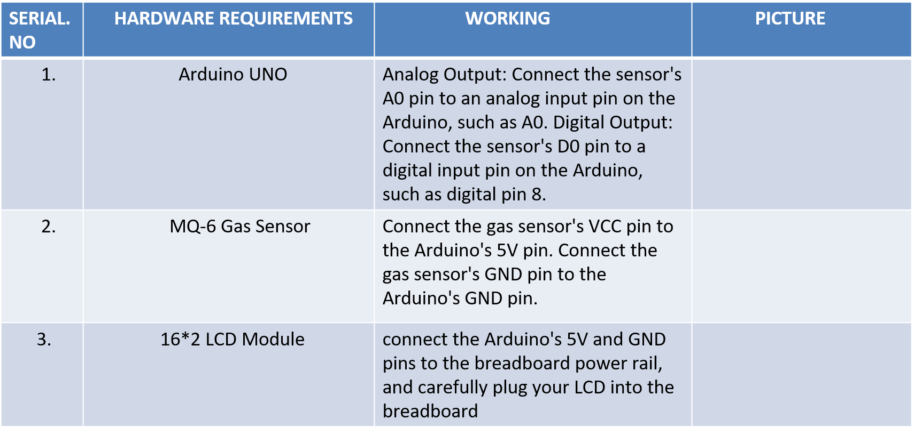
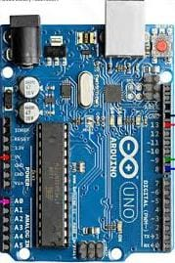
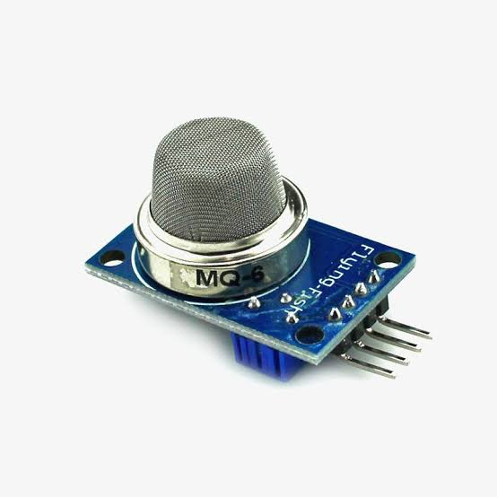
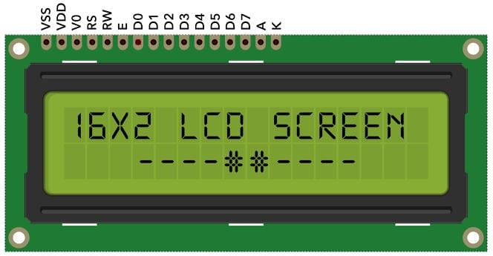
Hardware Requirements
MQ-2 Sensor
15-08-2025 10:53
6

Slide 7
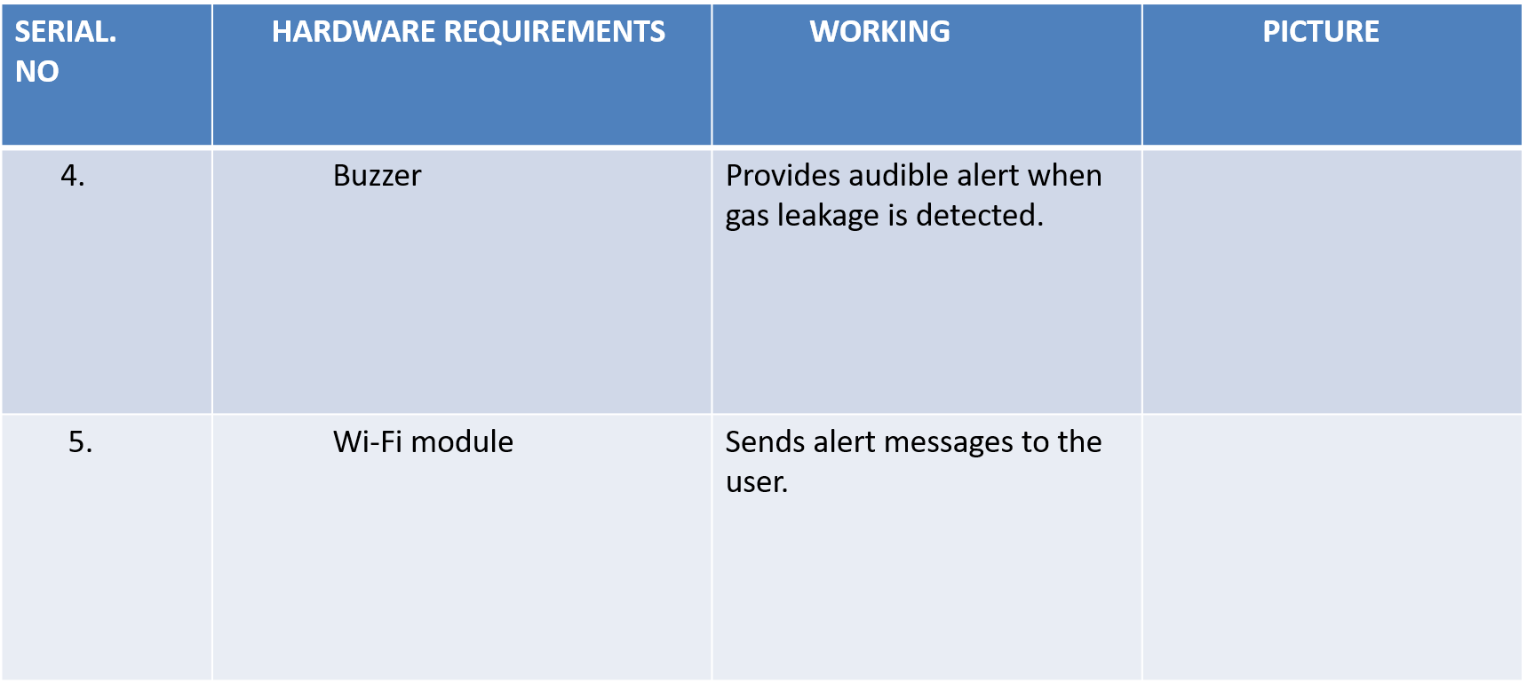

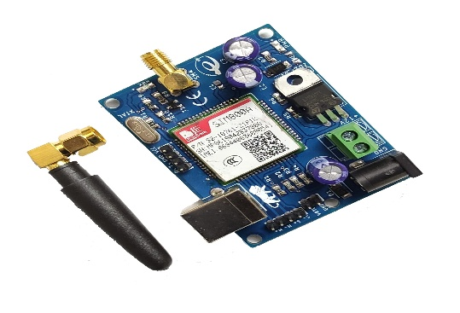

Slide 8
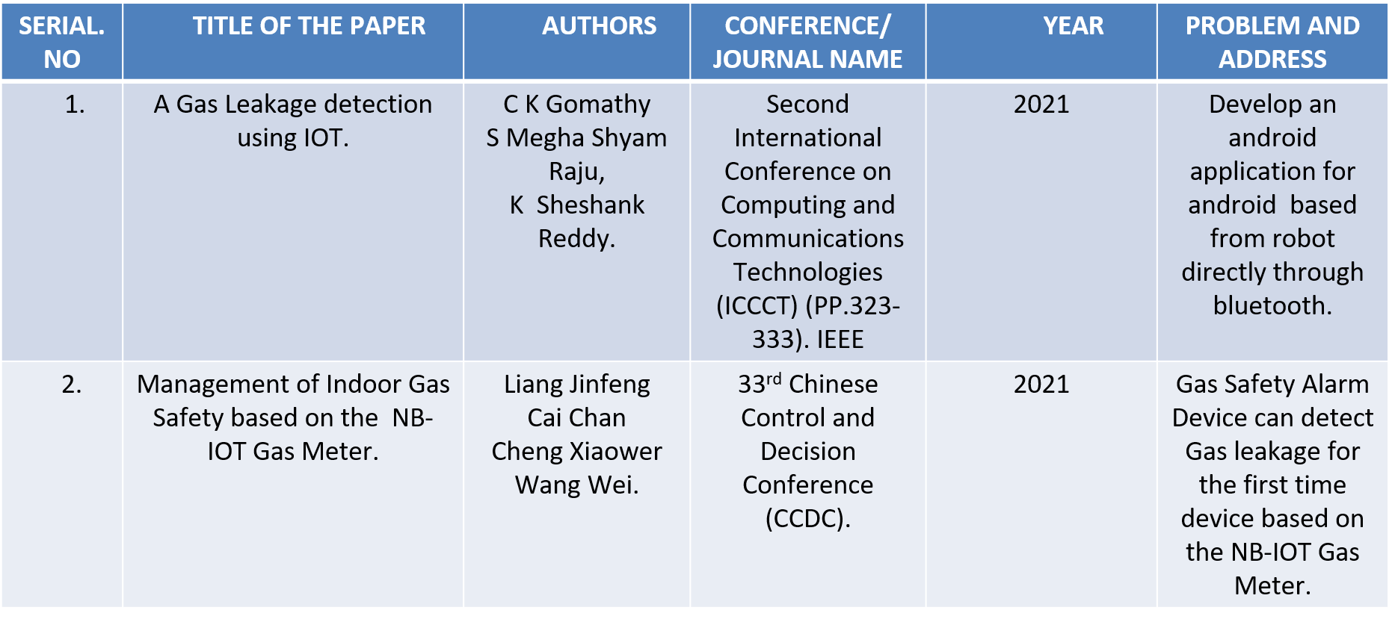
Literature Survey
8

Slide 9
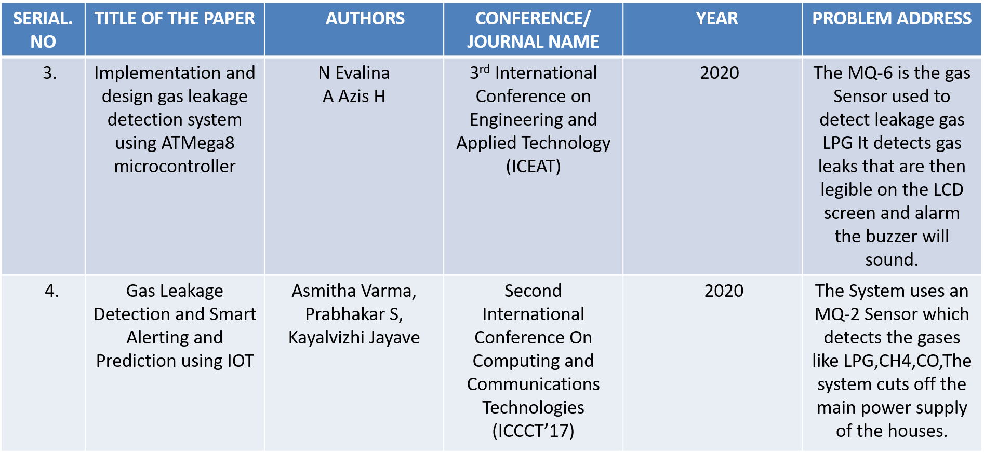

Slide 10
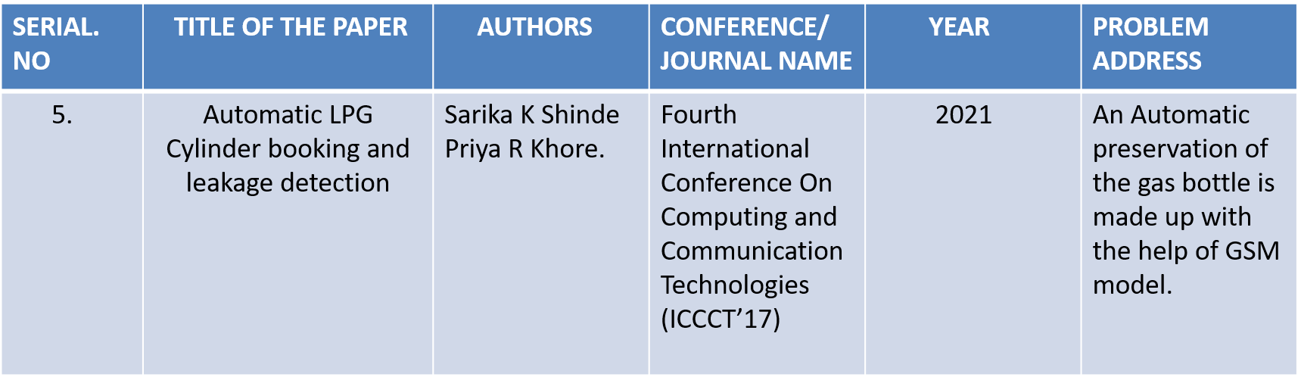

Slide 11
Methodology
The MQ-2 sensor is connected with the Arduino to detect LPG concentration in atmosphere and triggers the buzzer.
Connect LCD display for the leakage status and the exhaust fan to reduce gas concentration.
Connect the GSM module to send an alert message to the user’s mobile phone and servo motor automatically turns off the gas regulator to ensure quick response and safety.
By continuous monitoring of sensor readings.

Slide 12
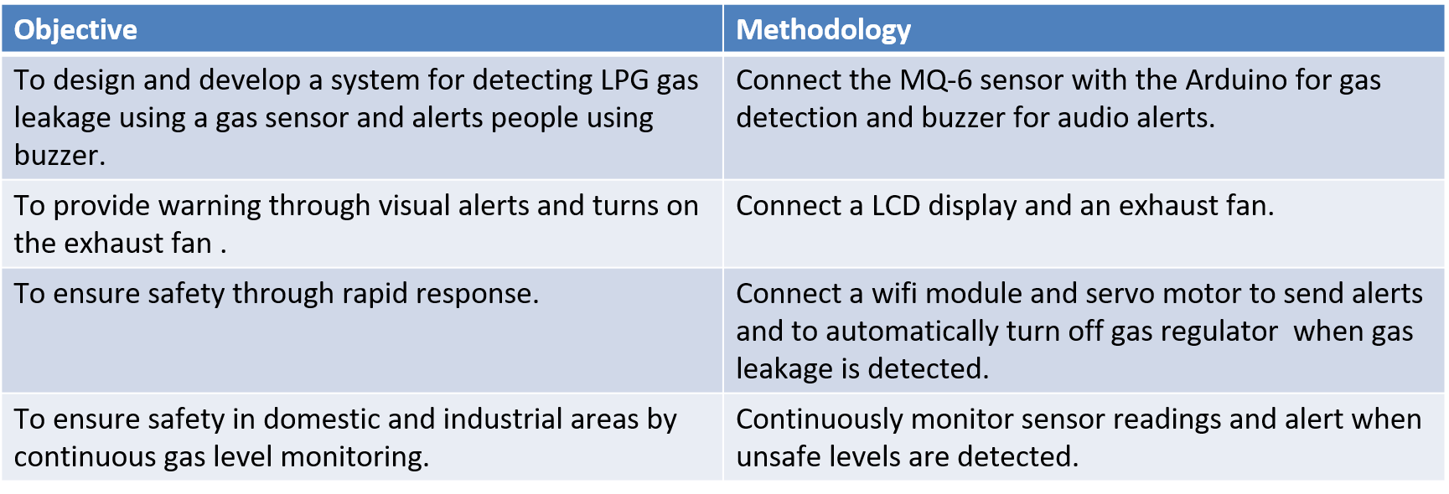
Objectives & Methodology
2

Slide 13

Block diagram of the project
Show data and send alert
message
WIFI module
Gas
sensor
LCD
Arduino UNO
Buzzer
Power
supply
Fan
Servo
motor
Turn off gas regulator

Slide 14
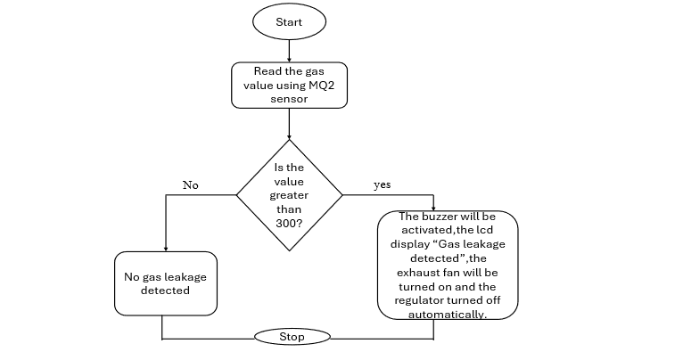
Flow Chart

Slide 15
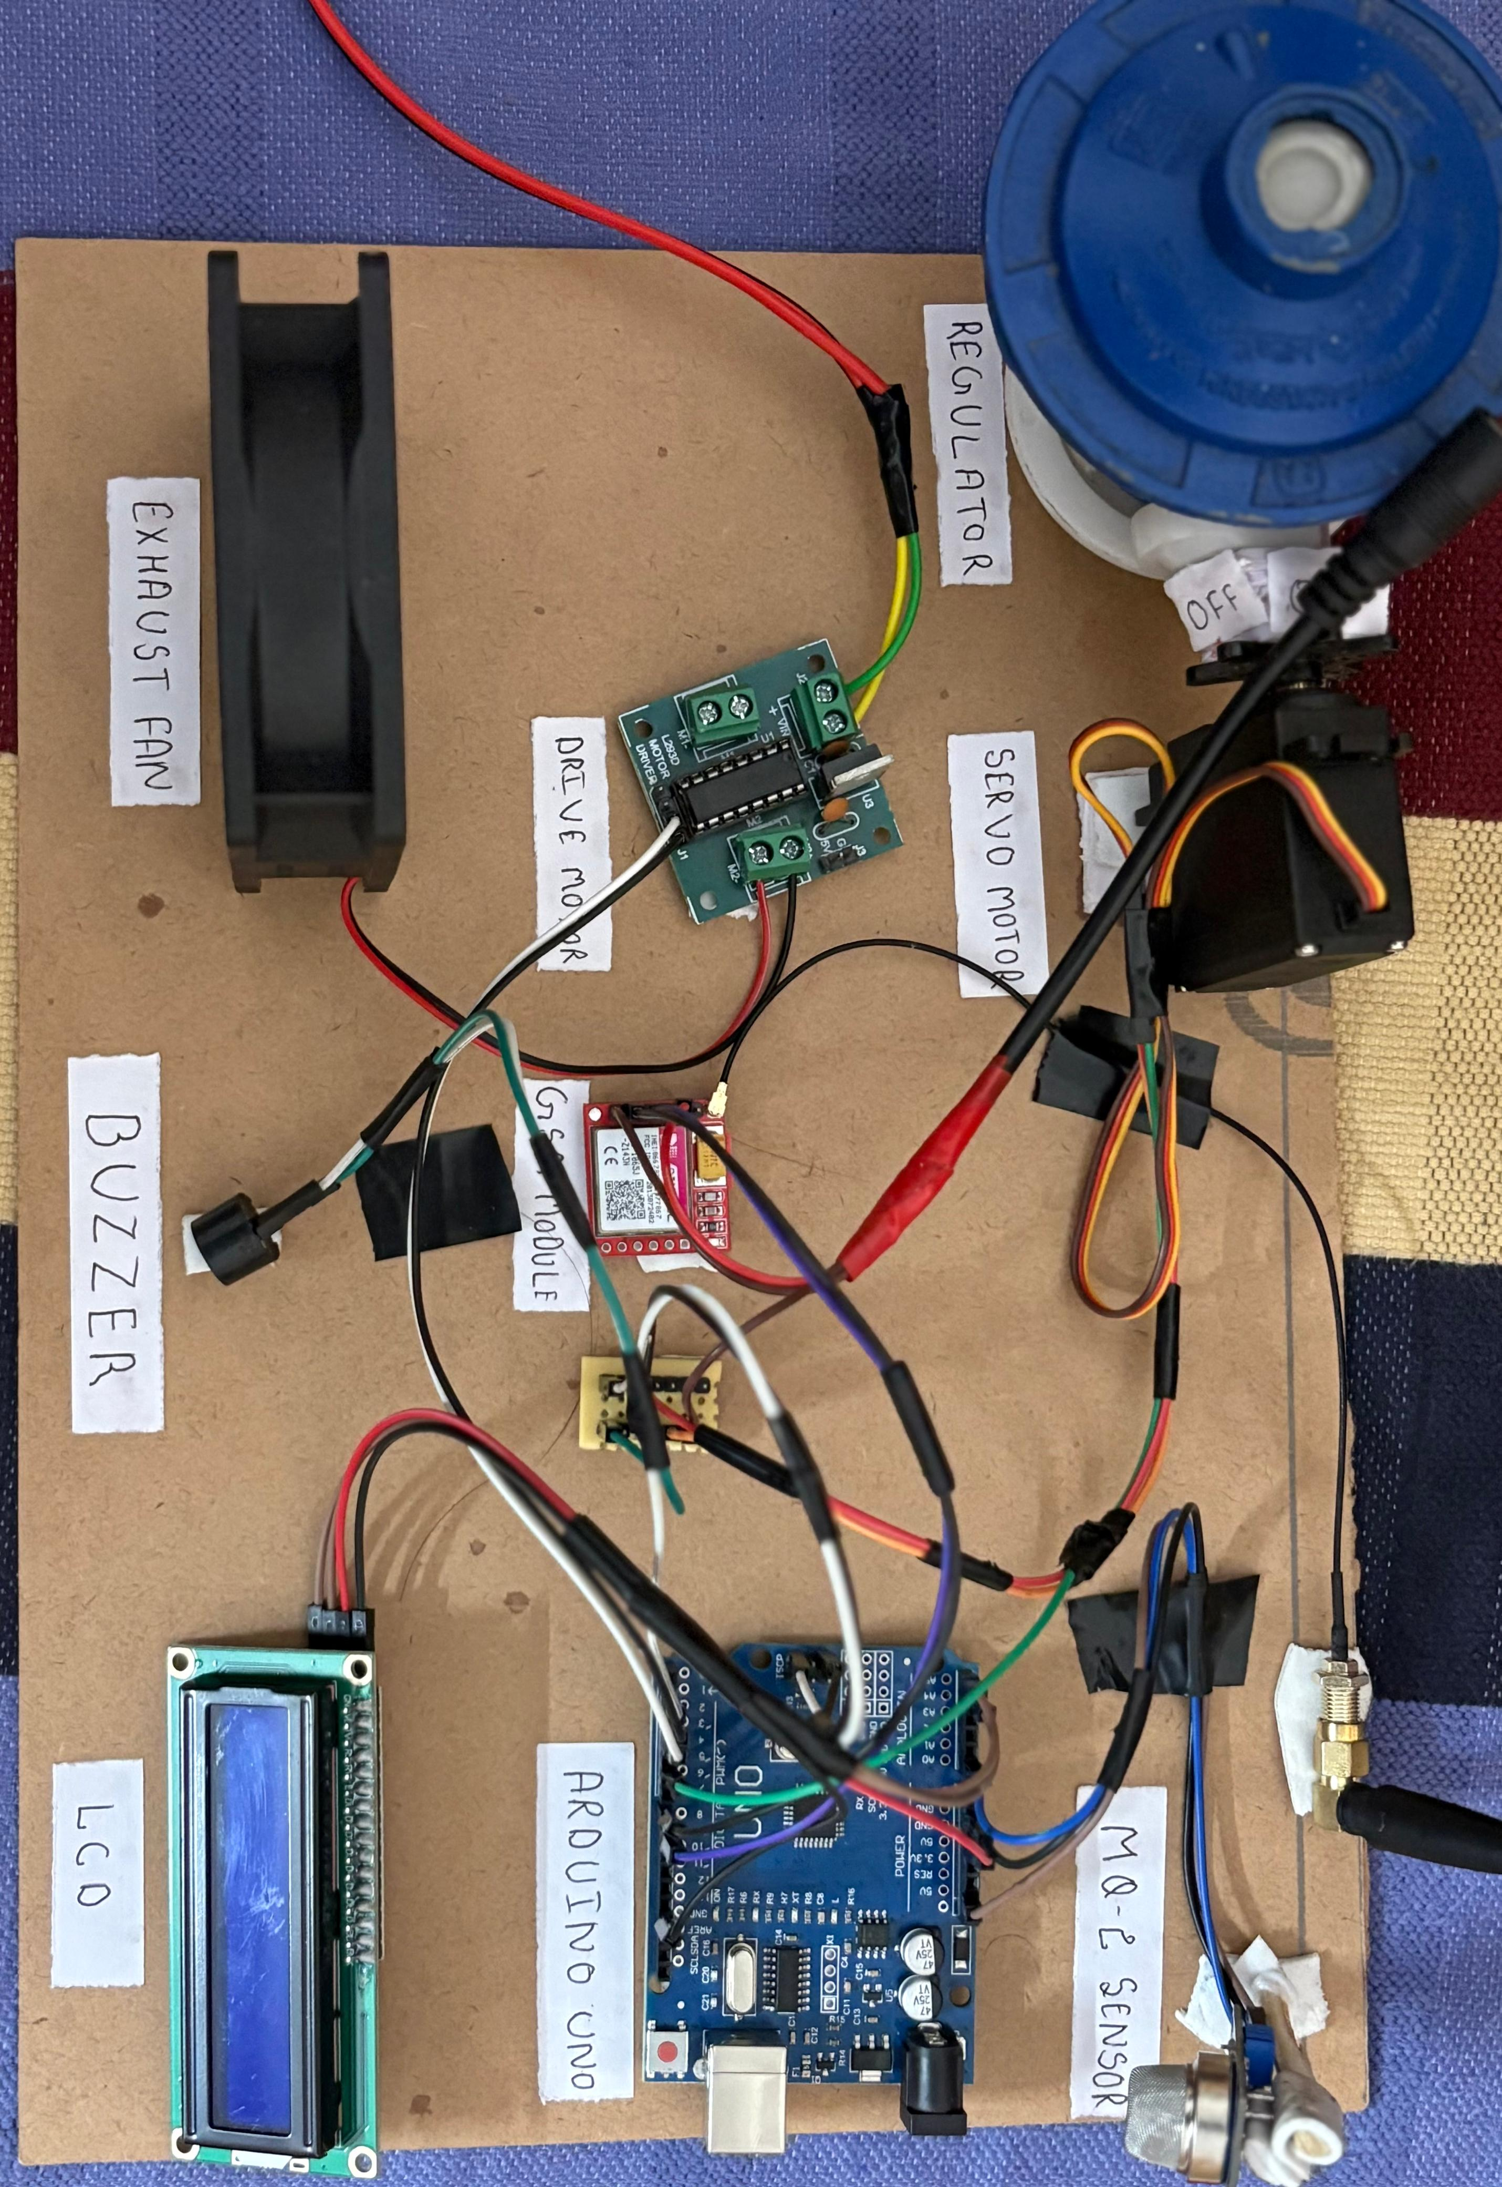
Circuit Diagram

Slide 16
Implementation Details
The system is built using Arduino UNO as the main controller.
MQ-2 sensor detects LPG gas concentration and sends signals to Arduino.
Buzzer provide audio alerts and LCD display provides visual alerts during the gas leakage.
Exhaust fan is automatically turned on to reduce gas concentration.
Sends SMS through GSM800L alert to the user for remote warning and automatically turns off the gas regulator.

Slide 17
Results Obtained
The system detected LPG gas quickly during testing.
The buzzer and LED turned ON when leakage was found.
The exhaust fan automatically activated to reduce the gas.
Gas levels came back to normal after a few seconds.
The system worked correctly every time .

Slide 18
Advantages
This ensures timely awareness.
Prevent accidents like fire or explosions.
Provides a low-cost and reliable safety solution for households and industries.

Slide 19
Future Scope and Enhancements
Automatic Gas Shut-off: Integrating a Relay Module and a Solenoid Valve to automatically cut off the gas supply source when a leak is detected.
Remote Notification: Adding a GSM/Wi-Fi module (like an ESP8266 or SIM900) to send SMS or app notifications to the user's mobile phone, allowing for remote alerts and monitoring.
Power Optimization: Designing the circuit for low-power consumption to enable portability and battery operation for greater deployment flexibility.

Slide 20
References
1.R. K. Pathinarupothi, P. Durga and E. S. Rangana. IoT-Based Smart Edge for Global Health:
Remote Monitoring with Severity Det and Alert Transmissions vol. 6, no. 2, pp. 2449-2462,
April 2019.
2.Mahalingam, A., R. T. Naayagi, and N. E. Mastorakis. Design and implementation of an
economic gas leakage detector.pp. 20-24, 2012.
3.Attia, Hussain A., and Halah Y. Ali. Electronic Design of Liquefied Petroleum Gas Leakage
Monitoring, Alarm, and Protection System based on Discrete Components. vol. 11, no. 19,
pp. 9721-9726, 2016.
4. Apeh, S. T., K. B. Erameh, and U. Iruansi.Design and Development of Kitchen Gas Leakage
detection and Automatic Gas Shut off System. vol. 5, no. 3, pp.222-228, 2014.
5.T.Soundarya, J.V. Anchitaalagammai, G. Deepa Priya, S.S. Karthick Kumar, MC-Leakage:
Cylinder LPG Gas Leakage Detection for Home Safety. vol. 9, no. 1, Ver. VI, pp. 53-58, Feb.
2014.

Slide 21
Conclusion
The LPG Gas Leakage Detector using Arduino successfully detects the presence of LPG gas in the environment and provides instant alerts to prevent hazardous situations.
By using the MQ-2 gas sensor, the system continuously monitors gas concentration levels and triggers a buzzer and LED alarm when leakage is detected.
The project demonstrates how a simple, low-cost microcontroller-based system can significantly enhance safety in homes, kitchens, restaurants, and industrial areas.
Overall, the project proves to be an effective and reliable solution for early gas leakage detection and can be further improved by adding wireless notifications, automatic shutdown mechanisms, and IoT-based monitoring for enhanced safety and convenience.

Slide 22


